Slide 1
Analysis of Crime Rates in NYC
Jack Breingan

Slide 2
Data
Crime data taken from NYPD Complaint data: https://data.cityofnewyork.us/Public-Safety/NYPD-Complaint-Data-Historic/qgea-i56
Neighbourhood lat/long coords from https://data.cityofnewyork.us/City-Government/Neighborhood-Names-GIS/99bc-9p23
Overall, 322812 valid rows of data, in 299 neighbourhoods.

Slide 3
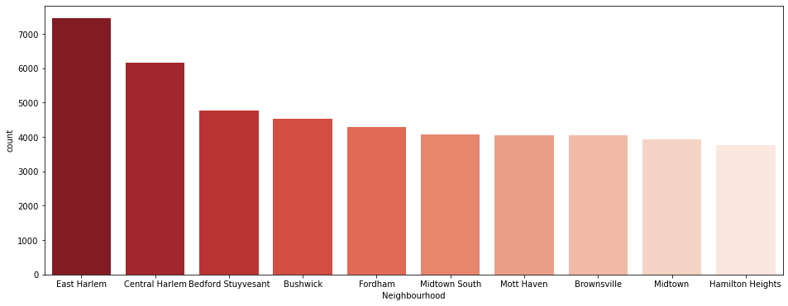
Highest Incident Neighbourhoods
High incident neighbourhoods include those popular with tourists, and those where incomes are low.
The Bronx, Brooklyn and North Manhattan have the highest incident areas.

Slide 4
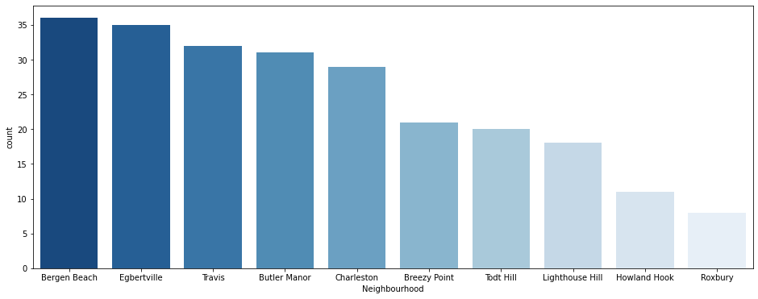
Lowest Incident Neighbourhoods
Safer neighbourhoods tend to be in places with higher average incomes and with plenty of public spaces.
Downtown Manhattan and Statten Island have particularly low incident rates.

Slide 5
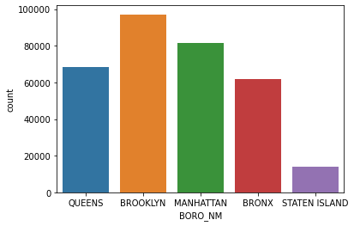
Crimes by Location
Brooklyn had the most incidents, and Staten Island the least issues.
Higher income areas
generally saw more
incidents than lower
income areas.

Slide 6
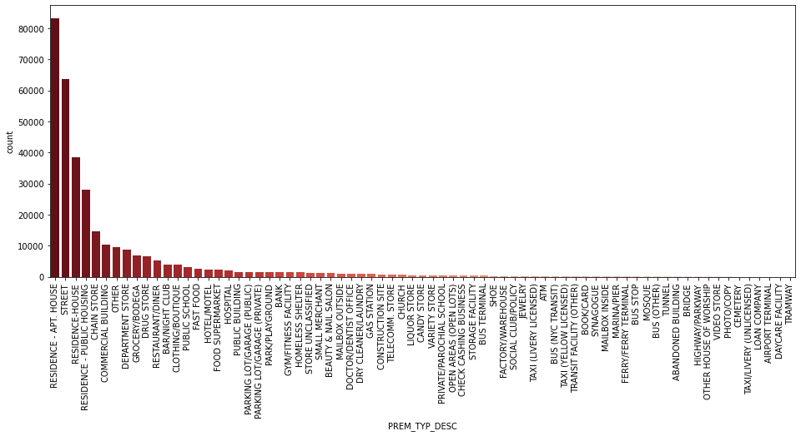
Crimes by Location II
Most incidents occur in residencies, with public locations seeing far less crime.
The exception is street crime, which is also high.

Slide 7
Crimes by Location II
While incidents in residencies are by far the most common, several types of businesses also have high counts.
Chain Stores, Grocery Stores, Drug Stores and Commercial Buildings collectively see high incident rates.
Public, open spaces see lower rates, as do locations dealing with children like daycares and schools.
Areas which store little of value also have low incident rates, such as airport terminals and loan companies.

Slide 8
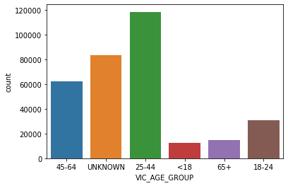
Victim Profiles
We examined incident counts by victim age group.
Most victims are in the 25-44 age group.
The age group with
the least incidents
is under-18s.
A high number of
incidents either did
not record victim age,
or did not have a victim.

Slide 9
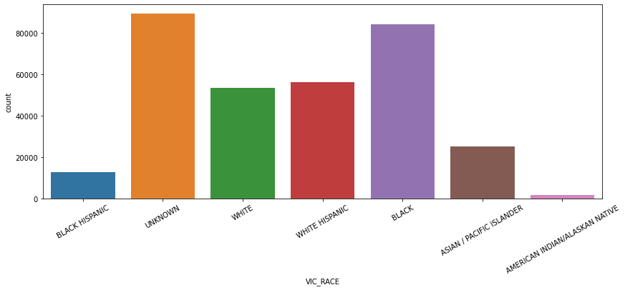
Victim Profiles II
Victim’s race was also recorded, with clear differences present.
Black and White Hispanic people were disproportionately represented as victims compared to the overall population.

Slide 10
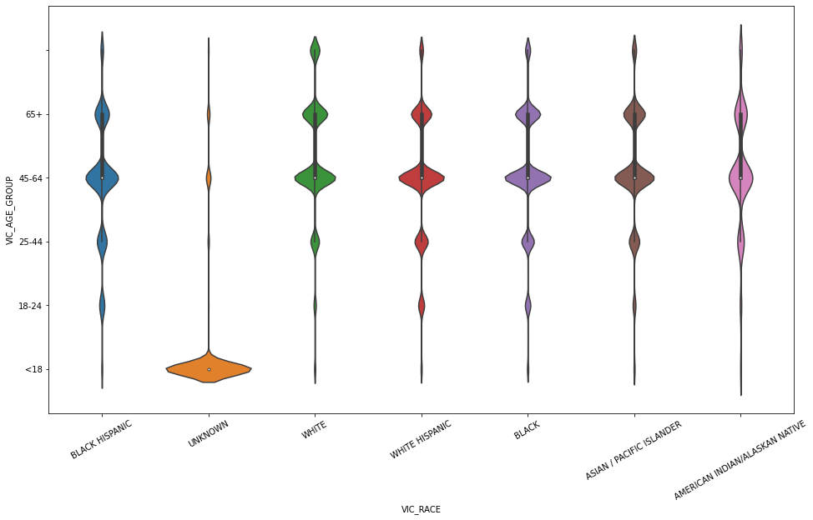
Victim Profiles III
Combining the age and race data, we found groups at more risk than others.
White victims were more likely to be elderly, while other groups
of victims are more
likely to be younger.

Slide 11
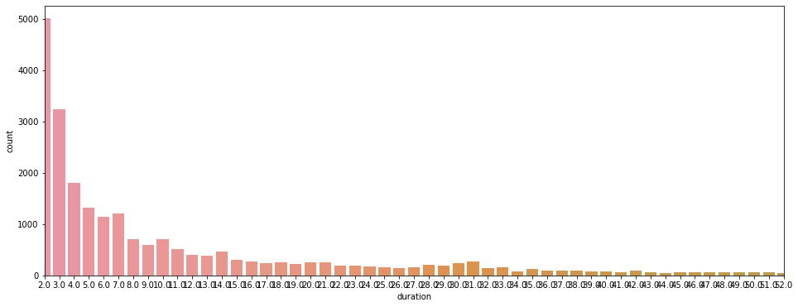
Incident Details
Most incidents were quickly resolved.
This implies that most are simple or less serious incidents, as we would expect.

Slide 12
Incident Details II
Incidents were more common in certain locations.
Most incidents occurred in residential locations.
Stores also reported many incidents.

Slide 13
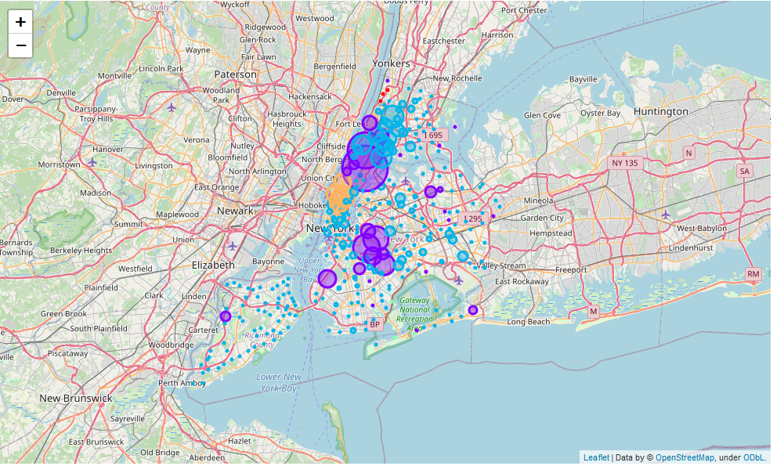
Similar Neighbourhoods
Neighbourhoods were clustered by incident similarity.

Slide 14
Similar Neighbourhoods II
4 main clusters identified.
Cluster 0, blue, represents a typical neighbourhood. These were the areas of least interest to our project.
Cluster 1, in red, and cluster 3, in green, displayed low levels of incidents. These areas included lots of public spaces and open areas.
Cluster 2, orange, in midtown Manhattan, is an area with many tourist attractions. This is likely to be what distinguishes it, as such areas always attract crime. The area contains high numbers of restaurants, as well as hotels and entertainment venues.

Slide 15
Similar Neighbourhoods III
Our outliers, in purple, represent areas not subject to local trends.
Outliers were split into high and low incident areas.
Low incident outliers featured public spaces, restaurants and were often near the water.
High incident areas featured high numbers of bars and stores, both areas where incidents were frequent.

Slide 16
Conclusions
Low Income areas need additional support to reduce crime rates.
Additional measures should be taken to protect residencies.
Certain types of businesses, notably convenience or chain stores, restaurants and bars, are more prone to incidents.
Tourist areas see high crime rates, and may need further attention.

